Slide 1
GPD_Agriculture_Services visualization
By:
Omnia Ahmed

Slide 2
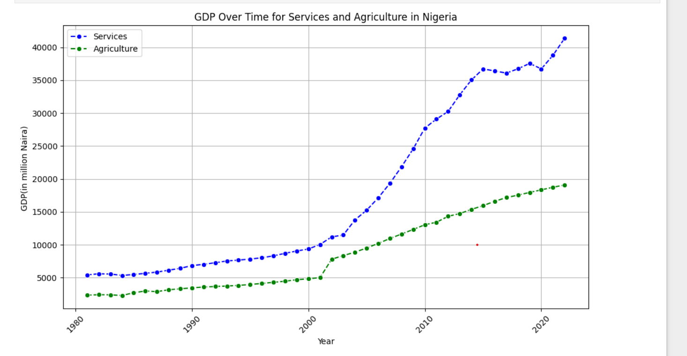
GDP Over Time for Services and Agriculture
The chart shows how Nigeria's Gross Domestic Product (GDP) has changed from 1981 to 2023 for services and agriculture.
Key Points:
Services Sector: The blue squares show that the GDP for services has greatly increased after 2000, meaning this sector has grown a lot.
Agriculture Sector: The green diamonds show that agriculture GDP has also increased, but not as quickly as services.

Slide 3
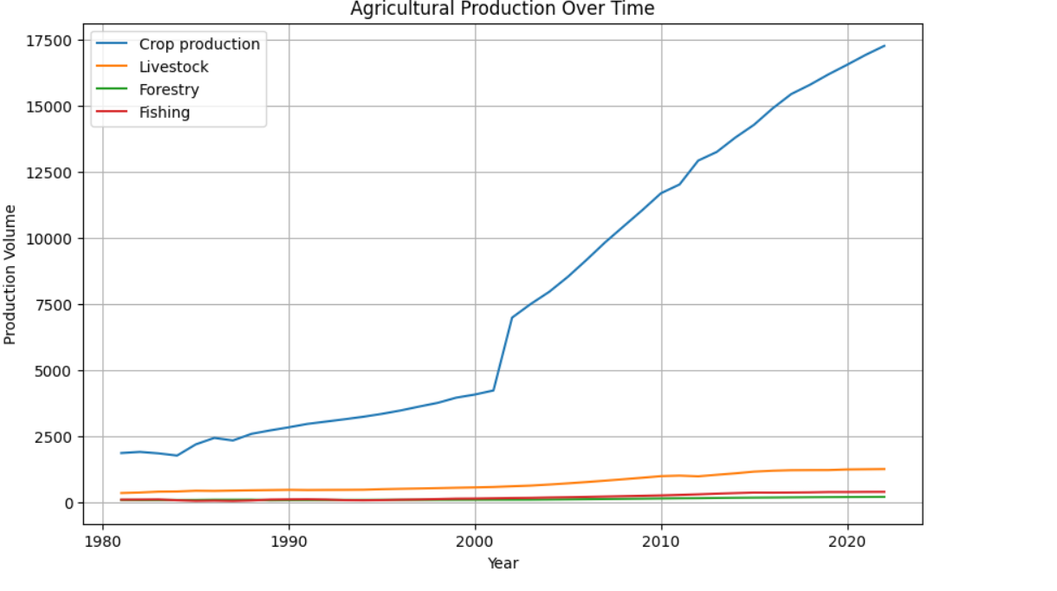
Agricultural Production Over Time
Crop production has displayed a consistent upward trend, indicating substantial and continuous growth over time. In contrast, the livestock sector has remained stagnant, performing close to the bottom of the graph compared to crop production. Furthermore, the forestry and fishing industries have also shown minimal growth when compared to crop production's upward trajectory.

Slide 4
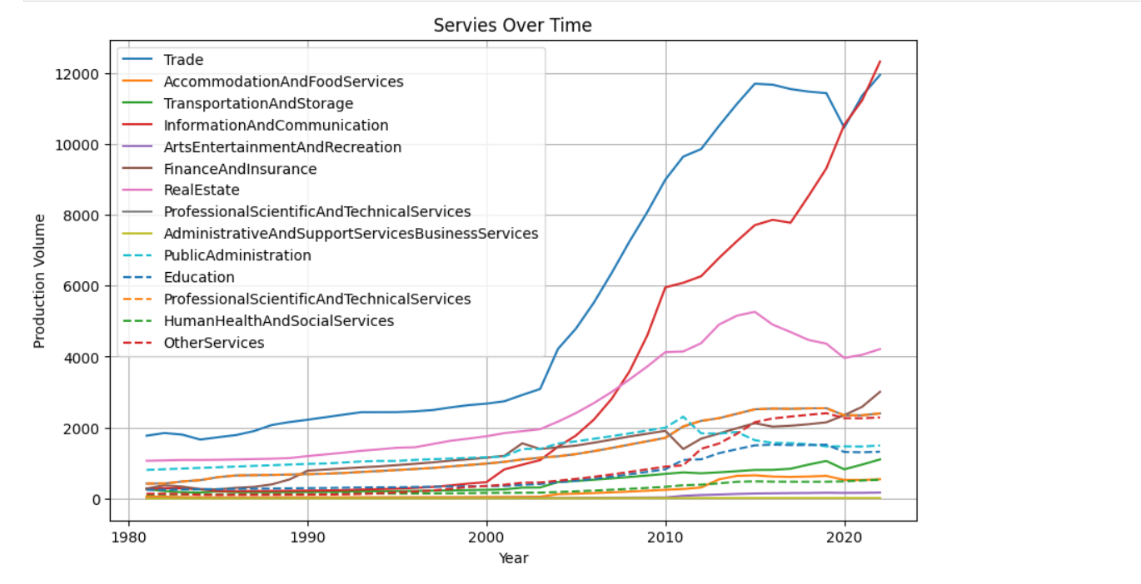
Services Over Time
In the time period from 1981 to around 2023, the production volume of various services showed the following trends:
Accommodation and Food Services: demonstrated moderate growth over the years.
Transportation and Storage: also showed steady growth.
Information and Communication: experienced significant growth, especially after 2000.
Arts, Entertainment, and Recreation: displayed fluctuations but no substantial trend.
Finance and Insurance: showed moderate growth.
Real Estate Activities: remained relatively stable.
Professional, Scientific, and Technical Services: experienced steady growth.
Education: no clear trend was observed.
Public Administration: remained relatively stable.
Human Health and Social Services: exhibited steady growth.
Other Services: no significant trend was identified.

Slide 5
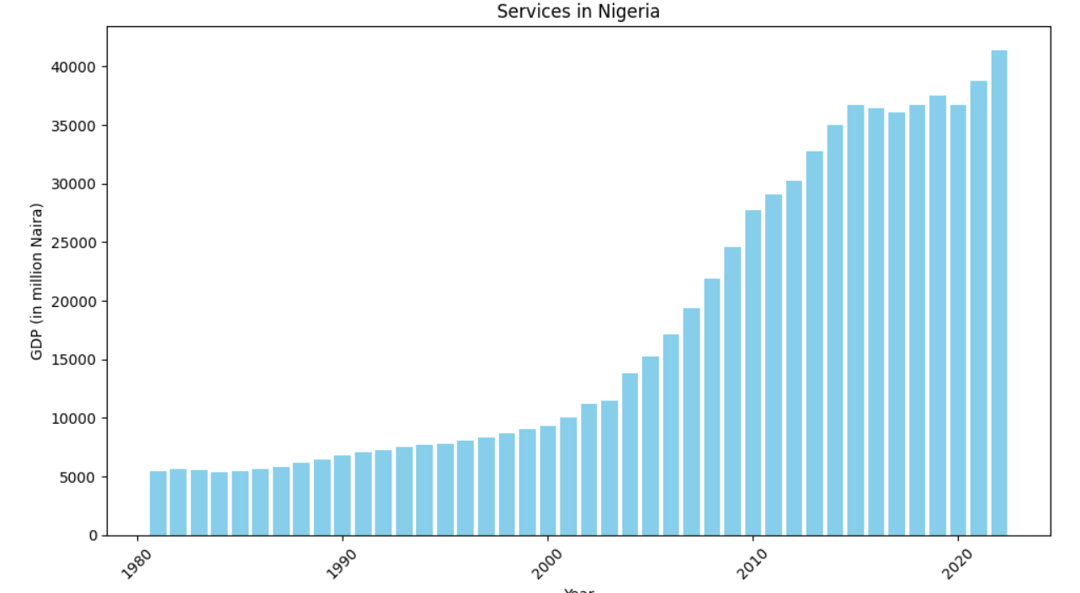
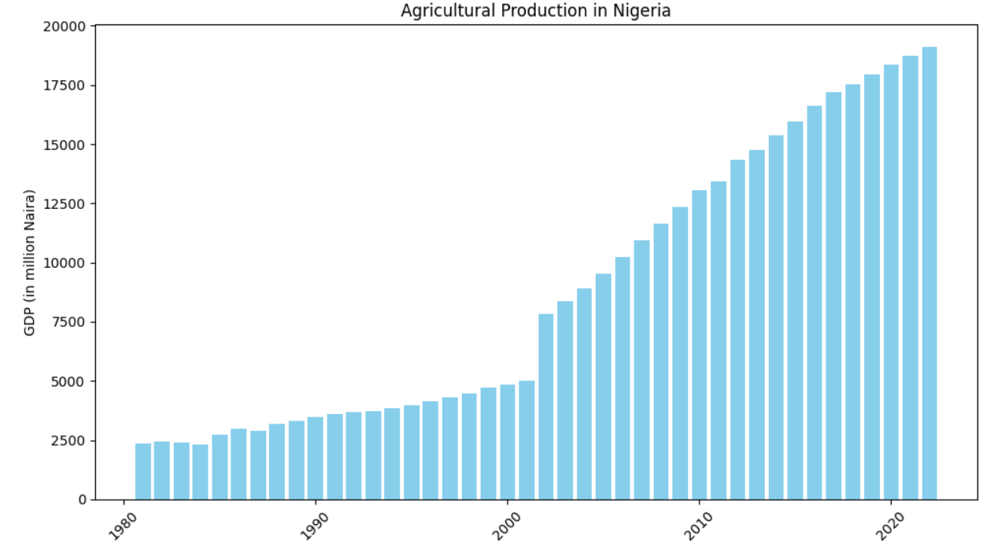
Compares GDP values across different years

Slide 6
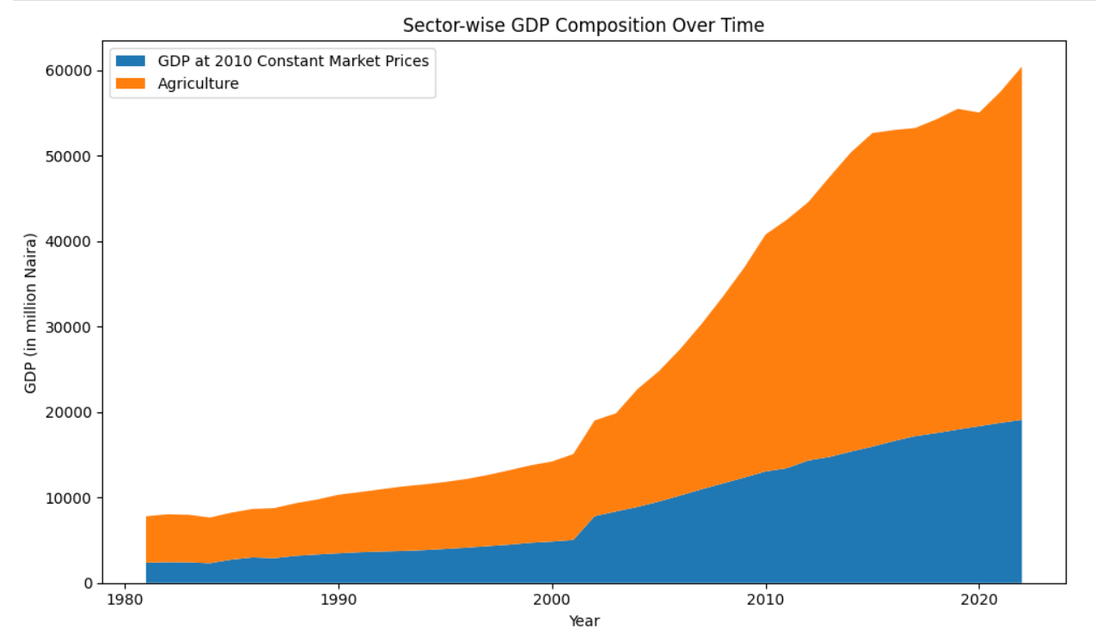
Illustrates the composition or cumulative aspects of GDP components over time
Services Sector: Services also contribute to GDP growth, although at a slower rate.
Agriculture Sector: Agriculture has the least growth in GDP contribution.
Period: The data spans from 1981 to approximately 2023.

Slide 7
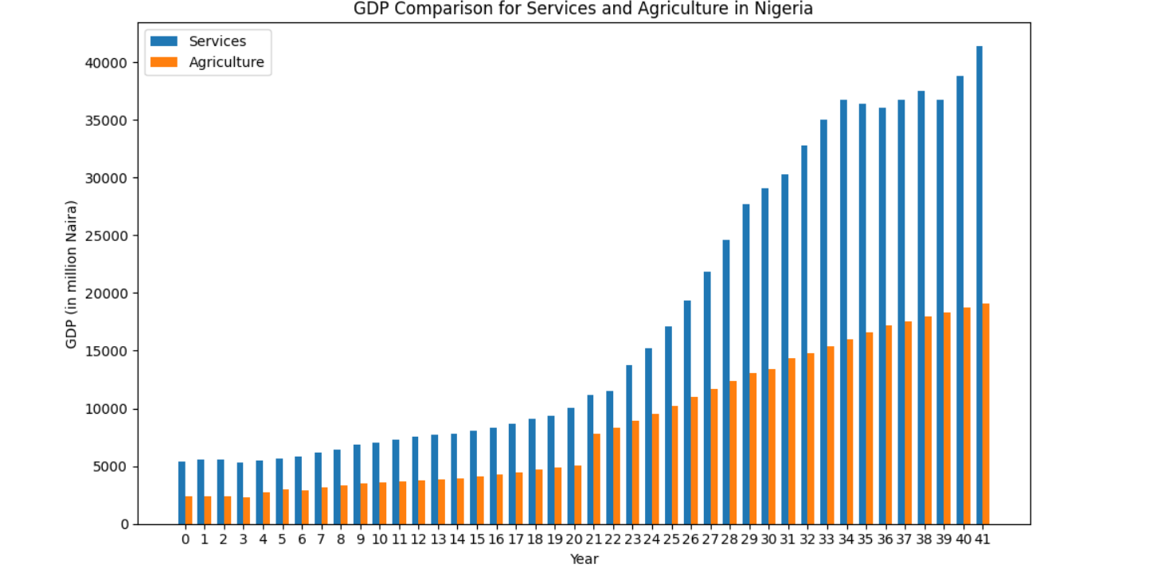
GDP Comparison for Services and Agriculture in Nigeria
The GDP Comparison for Services and Agriculture in Nigeria provides data on the GDP (in millions of Naira) for the services and agriculture sectors over a span of 41 years. Key points to note:
Services GDP: The blue bars show the GDP for the services sector, which has demonstrated steady growth over time.
Agriculture GDP: The orange bars represent the GDP for agriculture, which has consistently remained lower compared to services.
Trend: The data illustrates that services have become a larger component of Nigeria's economy compared to agriculture.

